Slide 1
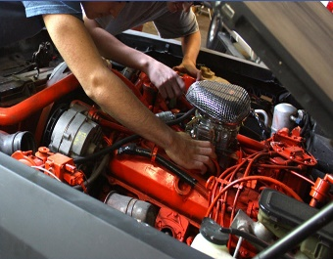
Open House and Career Fair
Thursday, April 11, 2024
Career Fair 9:00 AM – 12:00 PM
Open House 9:00 AM – 3:00 PM
ARE YOU LOOKING FOR A NEW CAREER?
WE HAVE OVER 20 PROGRAMS AVAILABLE
INDUSTRY CERTIFICATIONS AND PROFESSIONAL TRAINING IN AMERICA’S FASTEST-GROWING CAREERS!
FINANCIAL AID AVAILABLE
Ridge Technical College
The Open House event is open to the general public!
Automotive Service Technology, Welding, Pharmacy Technician, Air-Conditioning and Refrigeration, Network Support Services and many others
Explore our programs and talk to the employers while visiting
For additional information call (863)419-3060
7700 State Road 544 , Winter Haven, FL 33881
www.ridge.edu
A Polk County Public School
Please email lynn.keenan@polk-fl.net to reserve a career fair table!
7700 State Road 544 , Winter Haven, FL 33881
www.ridge.edu
A Polk County Public School
Accredited by:
The Council on Occupational Education
7840 Roswell Road
Atlanta, GA 30350
(770)396-3790
Cognia
9115 Westside Parkway
Alpharetta, GA 30009
(888)413-3669

